Slide 1

TERM PROJECT ON: ADAPTIVE CRUISE CONTROL WITH AUTOMATIC SPEED REDUCTION SUBMITTED TO: Prof. Nashwan J Sebi
WINTER 2023 ECE 5415
MICROCOMPUTER BASED CONTROL SYSTEMS
School of Engineering and Computer Science
SUBMITTED BY: SUBMITTED ON :
GROUP J
UNNIMAYA KARUTHEDATH
Niranjan Chennasamudram Balaji

Slide 2
CONTENTS
INTRODUCTION
HARDWARE
SOFTWARE
DEMO
OBSERVATIONS

Slide 3
introduction
Our project aims to develop an autonomous car with advanced driver assistance systems (ADAS) using Arduino and Pixy 2 vision sensors. The ADAS systems include:
Forward collision control using an ultrasonic sensor
Adaptive cruise control
Lane keeping using Pixy 2 vision sensors for line detection and tracking
Traffic light recognition
Speed control using PID control algorithm in MATLAB and speed reduction on bar code detection

Slide 4
FEATURES
FORWARD COLLISION CONTROL
ADAPTIVE CRUISE CONTROL
LANE KEEPING
SPEED SENSING AND CONTROL USING PID

Slide 5
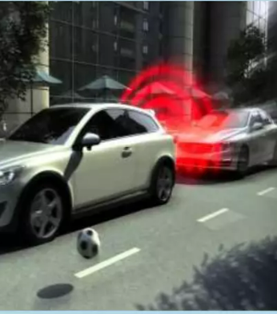
FORWARD COLLISION CONTROL
It is an advanced system designed to outright prevent or to reduce the effects of a forward collision.
We make use of the Ultrasonic sensor to calculate the distance from the vehicle or an obstacle in front by sending and receiving trigger and echo signals, respectively.
Uses ultrasonic sensor

Slide 6
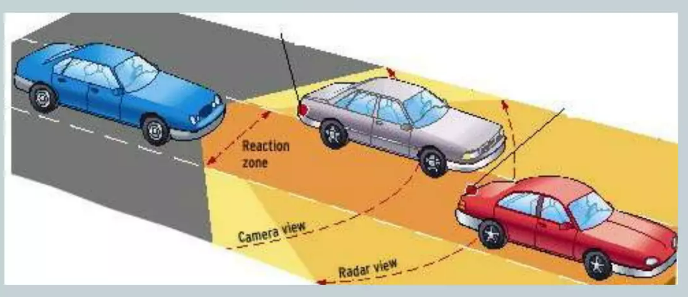
ADAPTIVE CRUISE CONTROL(ACC)
An intelligent form of cruise control that slows down and speeds up automatically to maintain a safe distance from the vehicle ahead.
Allows a vehicle’s cruise control system to adapt to the vehicle’s speed to the traffic environment.
Uses ultrasonic sensor

Slide 7
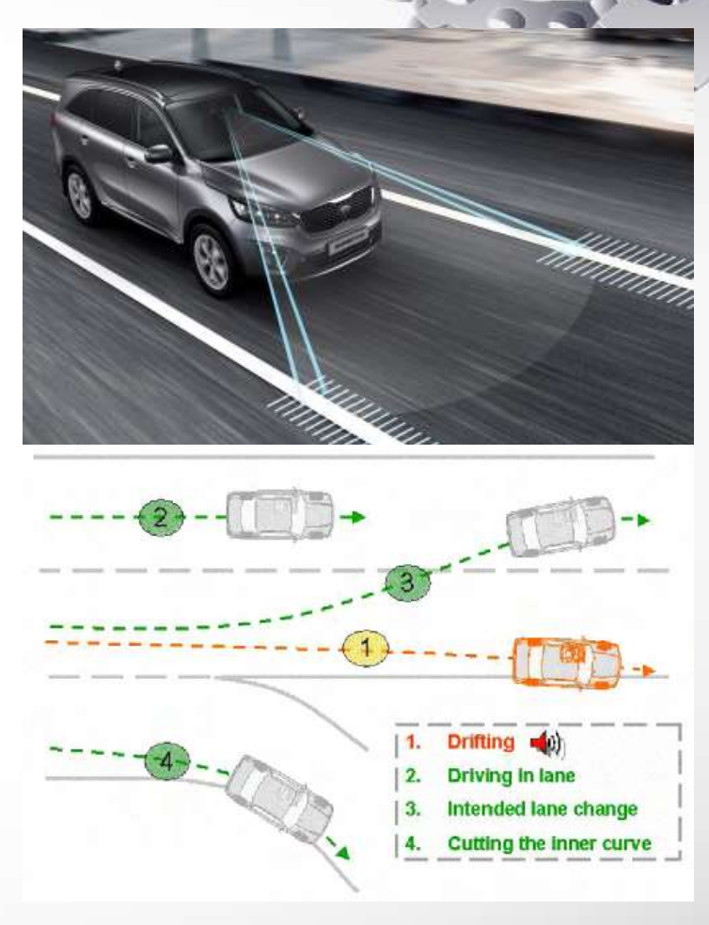
LANE KEEP ASSISTANCE
Lane keep assistance is a mechanism designed to keep the vehicleon the lane when it begins to move out of its lane. These systems are designed to minimize accidents collisions due to driver error, distractions and drowsiness.
Systems which warn the driver and, with no response, automatically take steps to ensure the vehicle stays in its lane (lane keeping assist, LKA/LKS).
Pixy2 line following feature will be used

Slide 8
Speed sensing , control and automatic reduction
Speed sensing using LM393 speed sensor.
PID algorithm for control
Using barcode detection for automatic speed reduction

Slide 9
HARDWARE
ARDUINO
PIXY2
CAR CHASSIS
ULTRASONIC SENSOR – HCSR04
SPEED MEASURING IR SENSOR – LM393

Slide 10

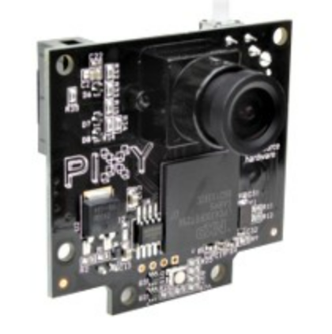
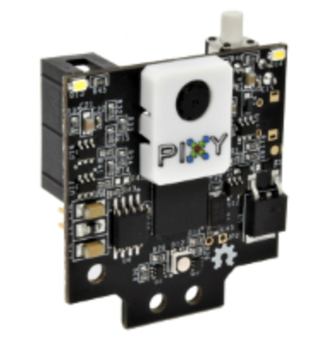

Pixy 2
Small, fast, easy-to-use, low-cost, readily-available vision system
Learns to detect objects that you teach it : Remembers up to 7 distinct color signatures
Improved framerate – 60 frames-per-second
C/C++ and Python are supported
Communicates via one of several interfaces: SPI, I2C, UART, USB or analog/digital output
Integrated light source
Tracking algorithms in addition to color-based object detection
Pixy2 has new algorithms that detect and track lines for use with line-following robots.
Pixy2 can be used to do lane keeping.
The new algorithms can detect intersections and “road signs” as well.
The road signs can tell your robot what to do, such as turn left, turn right, slow down, etc.
Pixy2 can detect and decode ColorCodes and present them as special objects

Slide 11

Line tracking using PIXY2
Pixy2 uses image (array) sensor for line-following .
Each of Pixy2's camera frames takes in information about the line being followed, its direction, other lines, and any intersections that these lines may form.
Can also read simple barcodes, which can inform your robot what it should do – turn left, turn right, slow down, etc.
Pixy2's algorithms can detect dark lines on a light background or vice-versa.
Pixy2 tracks each line, determining where each line moves in subsequent frames, so the line your robot is following remains so unless you tell it otherwise. The line your robot is currently following is called the Vector.
Pixy2 has an integrated light source for when the lighting needs a boost.

Slide 12
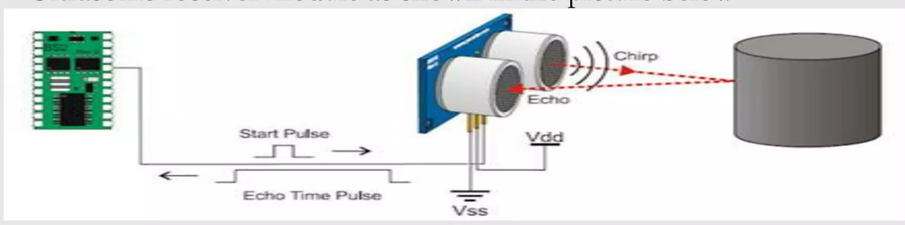
Hc sr04 ultrasonic sensor
HC-SR04 ultrasonic distance sensor actually consists of two ultrasonic transducers.
One acts as a transmitter that converts the electrical signal into 40 KHz ultrasonic sound pulses. The other acts as a receiver and listens for the transmitted pulses.
When the receiver receives these pulses, it produces an output pulse whose width is proportional to the distance of the object in front.
This sensor provides excellent non-contact range detection between 2 cm to 400 cm (~13 feet) with an accuracy of 3 mm.

Slide 13
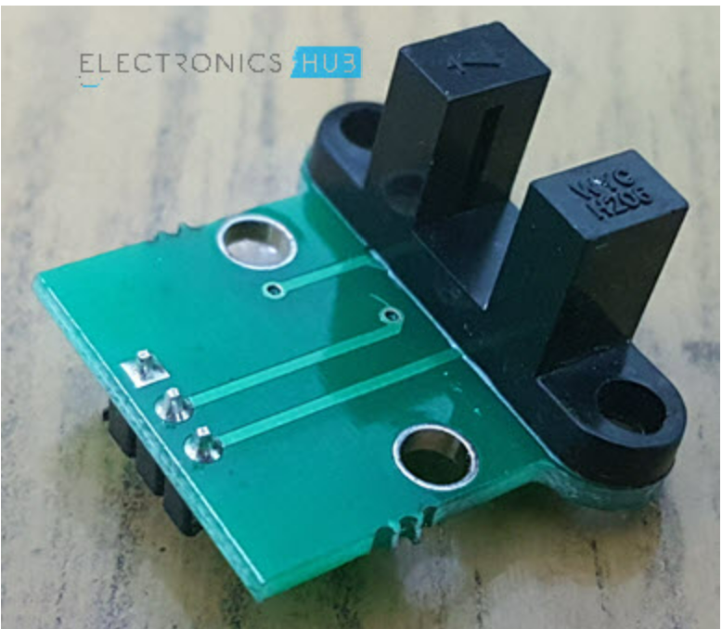
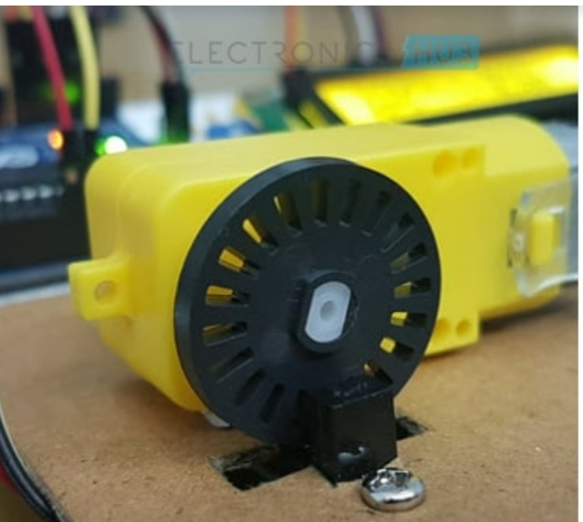
LM393 SPEED SENSOR MODULE
The sensor part of the LM393 Speed Sensor module consists of an Infrared LED and an NPN Photo Transistor
The signal from the photo transistor is given to the LM393 and based on the presence or absence of an object between the Infrared LED and the Photo Transistor, the Output of the LM393 IC will either be HIGH or LOW.
An encoder wheel(20 holes) has to be mounted on the top so that it passes through the gap provided in the housing i.e. between the Infrared LED and NPN Photo Transistor.
When the wheel makes one rotation, the infrared light from the IR LED is obstructed for 20 times from falling on the photo transistor.

Slide 14
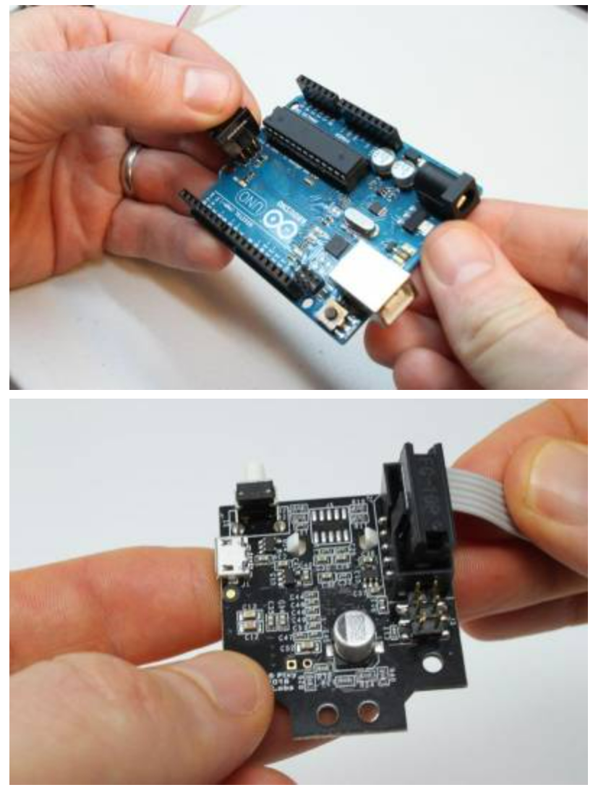
Connecting pixy 2 to arduino
The pixy 2comes with a cable that can be used to connect it to Arduino
Communication speed : 1 Mbits/second -> 6000 detected objects per second or 100 detected objects per frame
Once the object is detected Arduino controls the pwm so that motors can be made to move left/right or go straight , to follow it.

Slide 15
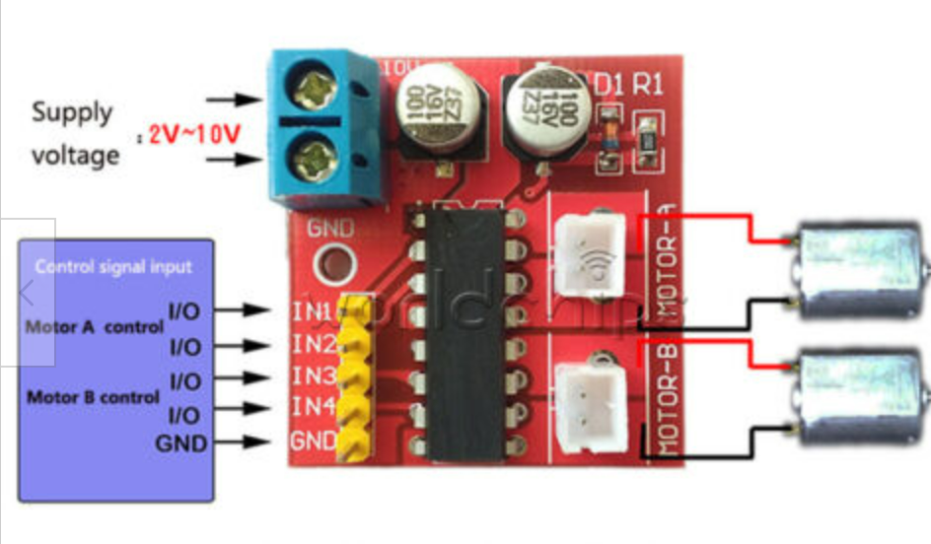
CAR chassis
Car chassis with 4 DC motors and an L298N Motor Drive Controller
Two standard H-bridges capable of driving a pair of DC motors, making it ideal for building a two-wheeled robotic platform.
The module has two direction control pins. The IN1 and IN2 pins control the spinning direction of motors on the left and IN3 and IN4 control the spinning direction of motors on the right.

Slide 16
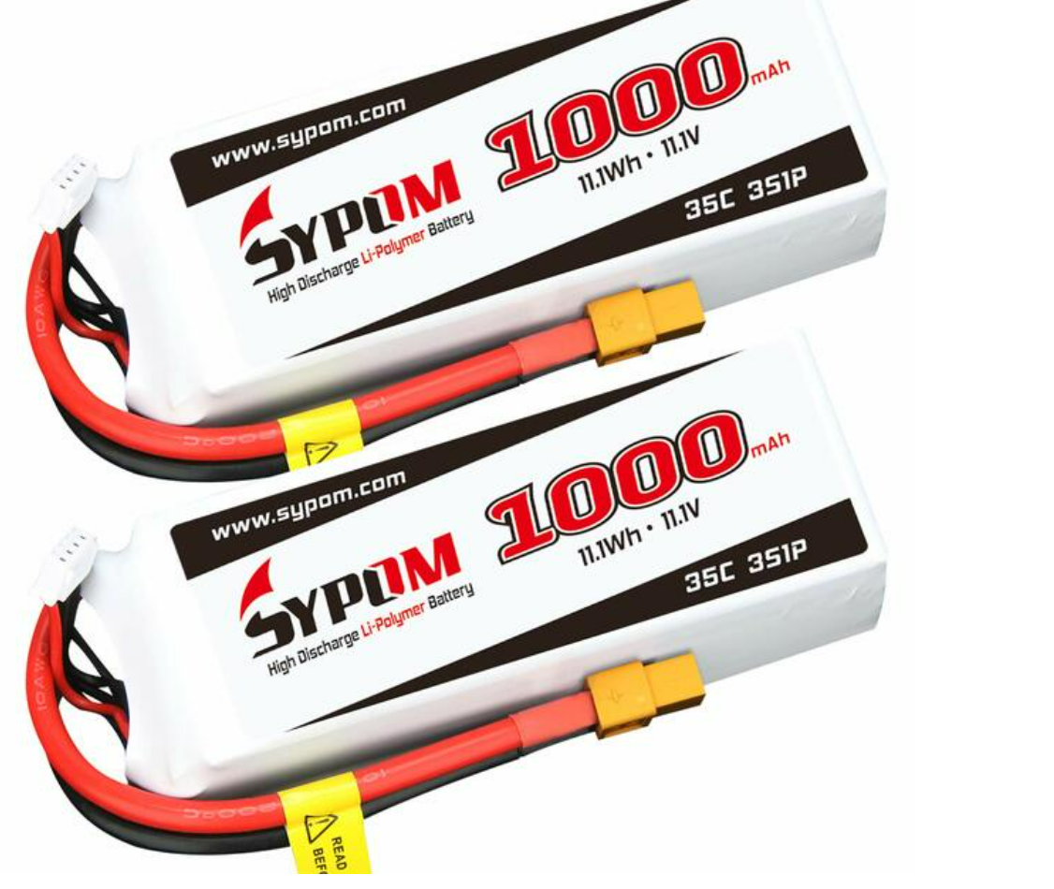
BATTERY
11.1 V Li-Po battery
Battery Capacity: 1000mAh
Quickly Rechargeable, long cycle life

Slide 17

SOFTWARE
PIXY CODE FOR OBJECT POSITION DETECTION
PWM FOR MOTOR CONTROL

Slide 18
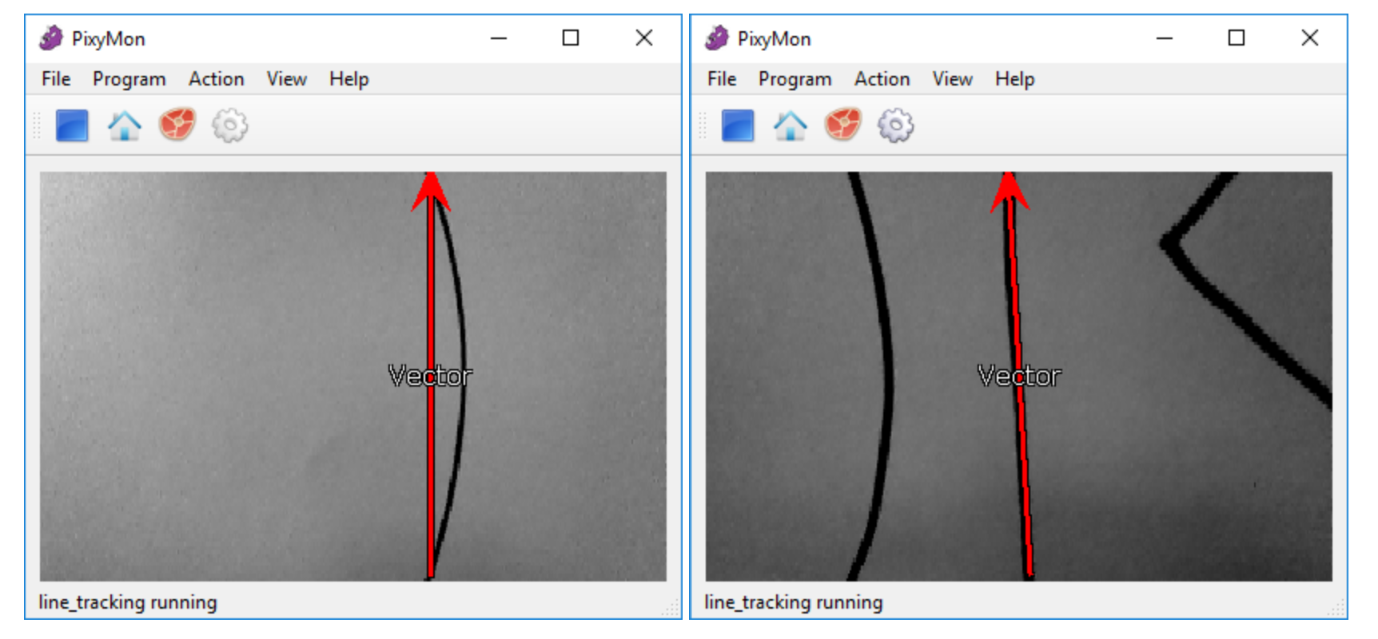
TRACKING A SINGLE LINE VS TRACKING MULTIPLE LINES
For lane keeping we want pixy to track multiple lines
getMainFeatures() - gets the latest features including the Vector, any intersection that connects to the Vector, and barcodes.
getAllFeatures()- gets all lines, intersections and barcodes that the line tracking algorithm detects.

Slide 19
Pwm (Pulse Width Modulation) for motor control
PWM is a technique in which the average value of the input voltage is adjusted by sending a series of ON-OFF pulses.
Average voltage is proportional to the width of the pulses, which is referred to as the Duty Cycle: Increased duty cycle , gives greater speed and vice versa.
When the robot is moving straight , both wheels are at duty cycle 70 (70/255= 27.5%)
When the robot is moving right , right wheels are at 40(15.6%) duty and left wheels are at 100 (39.2%) duty.
When the robot is moving left , left wheels are at 40(15.6%) duty and right wheels are at 100 (39.2%) duty.

Slide 20
Motor code

Slide 21
flowchart
No

Slide 22
BLOCK DIAGRAM

Slide 23
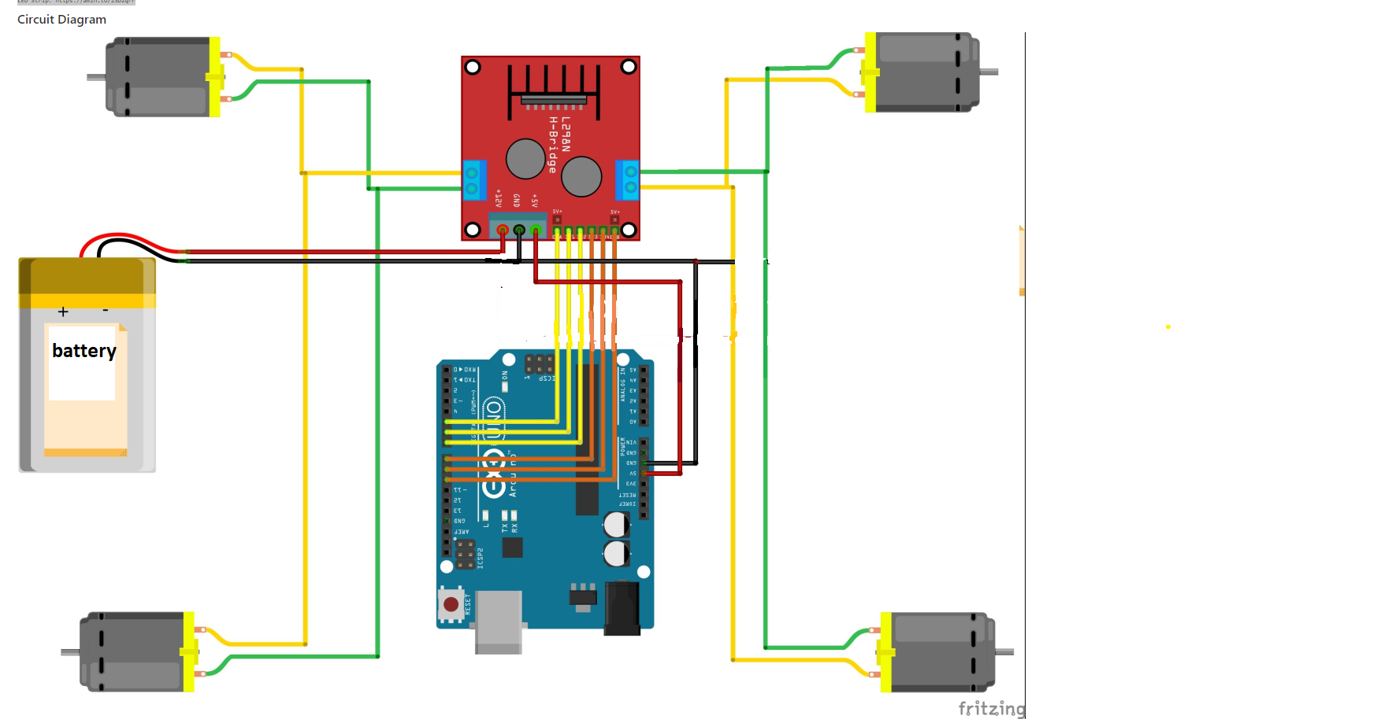
Circuit diagram

Slide 24
Demo

Slide 25
observations

Slide 26
References
https://www.youtube.com/watch?v=w_krOCBk1DE
https://www.computervision.zone/courses/object-following-robot-with-arduino/

Slide 27

Thank you

